Slide 1
Metro Bike Sharing Analysis Presented by Tushar Muley Feburary 6, 2022 Bellevue University DSC 680 | Professor B. Werner

Slide 2
Our Bike Path Today
Introduction
History Bike Sharing
Growth of Bike Sharing
Analysis of the Metro Bike Sharing
Predicting Outgoing Bikes
End of the Road

Slide 3
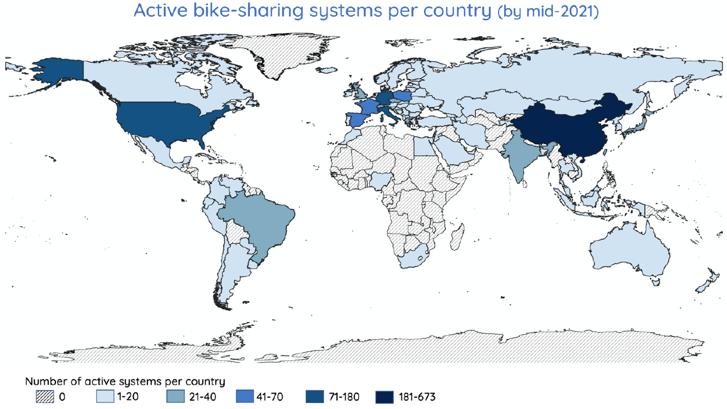
Bike Sharing is not small

Slide 4





History of Bike Sharing
Bike sharing has been around since 1965
Current version is called Gen 3 Bike Sharing
Asian Market – 833 Active Systems
European Market – 765 Active Systems
American Market – 203 Active Systems

Slide 5




Growth of Bike Sharing
In 2020 – 3 billion dollar value
In 2026 – 4 billion dollar expected value
Increasing use of e-Bikes
Uber acquired Jump Bike Sharing in New York

Slide 6
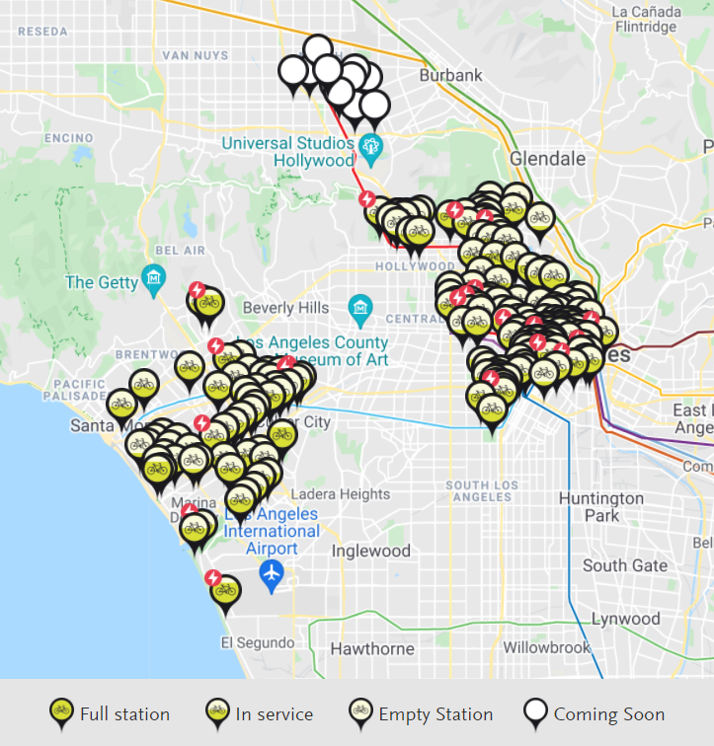
Metro Bike Operations
Started operation on July 7, 2016
93 Stations
1,400 Bikes Total
Located in:
Central LA
Downtown LA
North Hollywood

Slide 7


Analysis of Bike Sharing
What does ridership look like?
Usage better on weekends or weekdays?
How is ridership different between passholder?
Where are the busiest stations?
What features are influence trip count?
Predicting the outgoing trips?

Slide 8
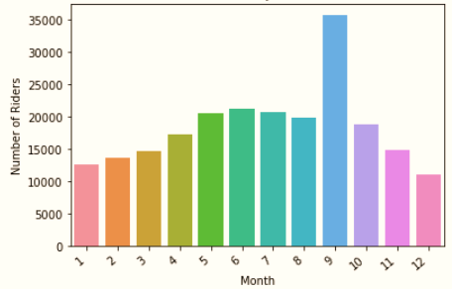
Ridership
Throughout the Year Ridership increases as it warms up
Drops in the cooler month
Yearly Average: 18,416 Riders
Peak of Sept. – 35,774
Low of Dec. - 10,976
Ridership by Month for 2021

Slide 9
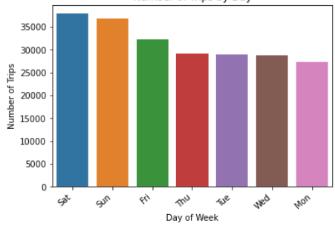
Weekend or Weekday?
Bar Chart of Busy Days
Weekend+ for sure!
Saturday – 37,900
Sunday – 36,887
Friday – 32,184
Average Weekday – 28,506
Monday – 27,248

Slide 10
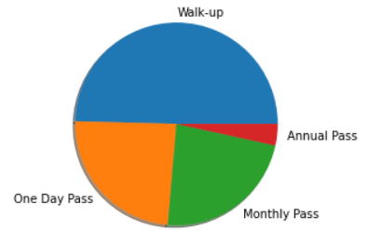
Members Only?
Walk-up make up 5,151,032 mins
One Day Pass 2,499,066 mins
Monthly Pass 2,381,513 mins
Annual Pass 356,897 mins
What does it mean?
Pie Chart of Passholders

Slide 11
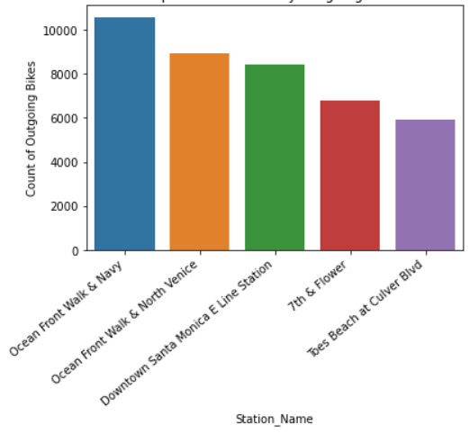
No Bike for YOU!
Bar Chart of Top 5 Busiest Stations
Busiest stations Bar Graph
Venice Beach Area
10,200 – Navy
8,552 – North Venice
Santa Monica
8,275 – R Line Station

Slide 12
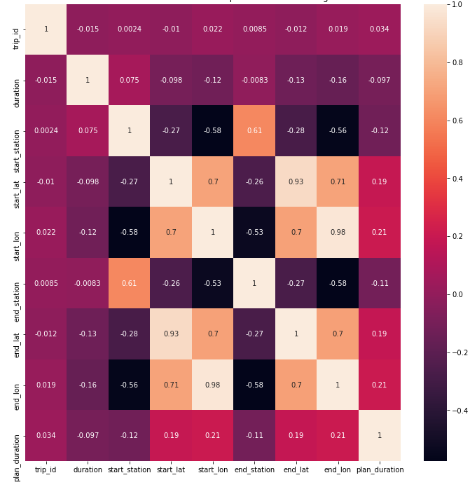


You an Influencer?
Correlation Matrix
Duration?
Bike Type?
Location?

Slide 13
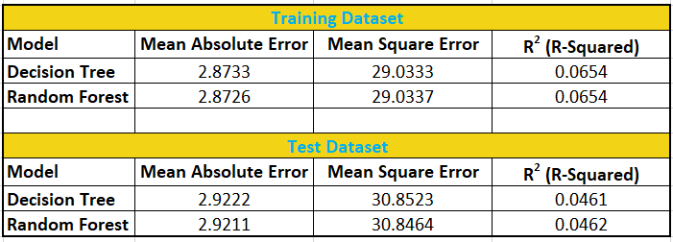
I Predict You’ll Runout of Bikes?
Completed two models
Decision Tree Regressor
Random Forest

Slide 14
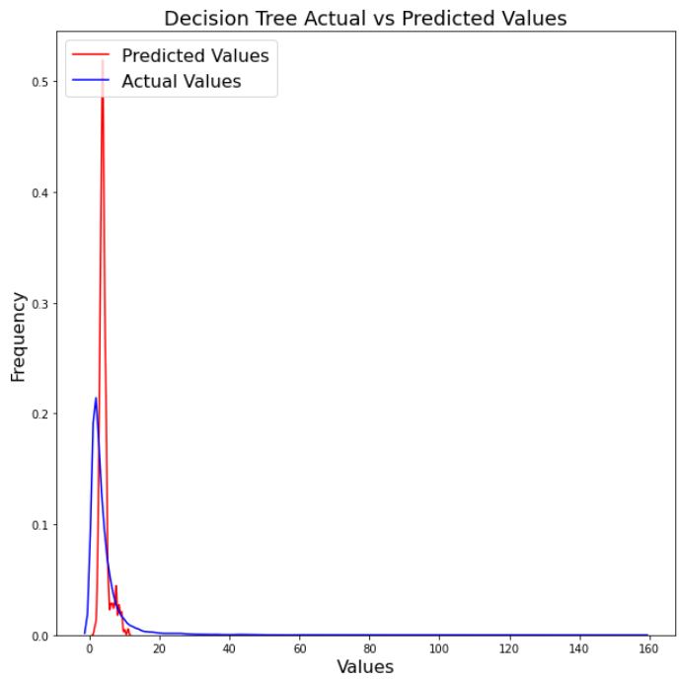
I Predict Cont…
Decision Tree Regressor
Mean Absolute Error: 2.8779
R-Squared: 0.0502
RMSE: 5.4033

Slide 15
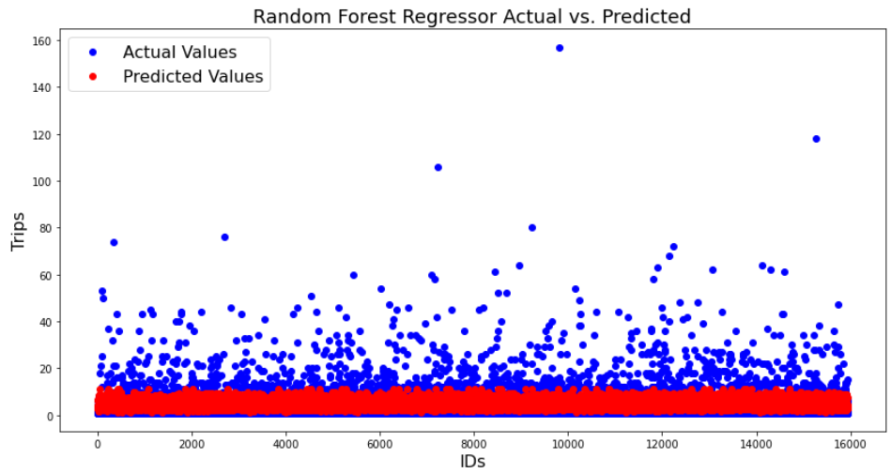
I Predict Cont…
Random Forest Regressor
Mean Absolute Error: 2.8778
R-Squared: 0.0502
RMSE: 5.4033

Slide 16
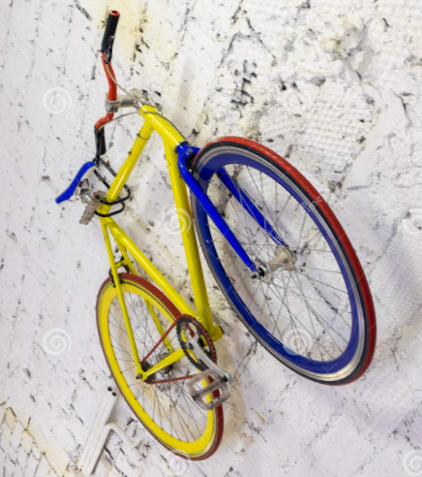
Thanks!
Any questions?

